Slide 1
Personal Health & Wellness Project
Mr. Oatway
Final Due: January 28, 2015 (20%)
Block ?

Slide 2
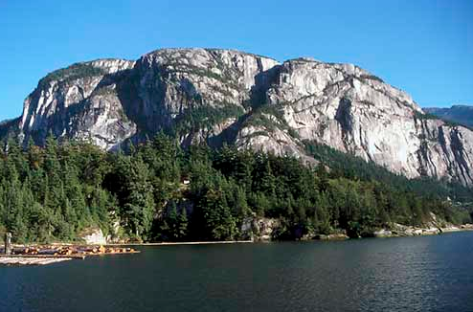
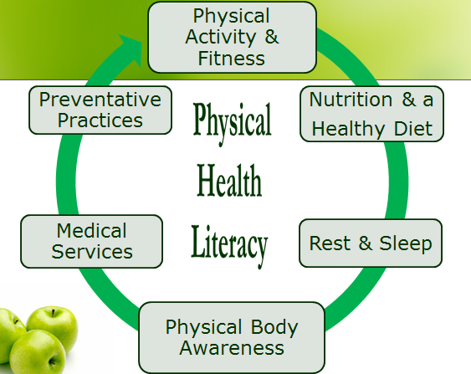
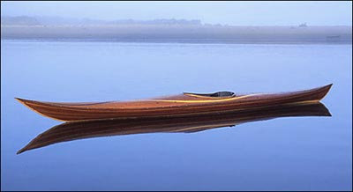
5 Year Goals

Slide 3
SMART GOAL SETTING
Specific: Goals need to be specifically directed towards a desired outcome. The more specific, the greater the chance of being accomplished than a general goal.
Measurable: Goals need to have a criterion of what to accomplish today, this week, this month, and this year for measuring progress toward the attainment of the goals.
Attainable: Goals and steps towards goals need to be reachable where measureable outcomes can be seen. These accomplishment needs to be known and celebrated.
Really Yours: Goals need to be yours and no one else’s directed towards outcomes in your live that you desire.
Timely: Goals need to have a time line of when they start and end.

Slide 4
5 Year Goals For each of your 5 year goals put together a SMART goal setting page breaking down the steps that you need to accomplish each of those goals!
Example: Next Week, Month, & Year Goals
Specific: Get my desk & e-mail under control & organized
Measurable: I can see it physically & feel it emotionally
Attainable: Yes, as I have allowed extra days to account for unknown factors
Really Mine: This is what I want and need to do.
Timely: By next Wednesday morning

Slide 5
Intellectual Health
Put a picture and a quote that represents yourself in this component.
Example

Slide 6
Bucket List Dreams & Goals
Can be pictures or lists

Slide 7
Questions & Answers of Self
What understandings do you have of self?
?
What questions do you have to better understand self?
?
What do you wanting to learn?
?
One “Personal Artifact” that represents you in this health component.

Slide 8
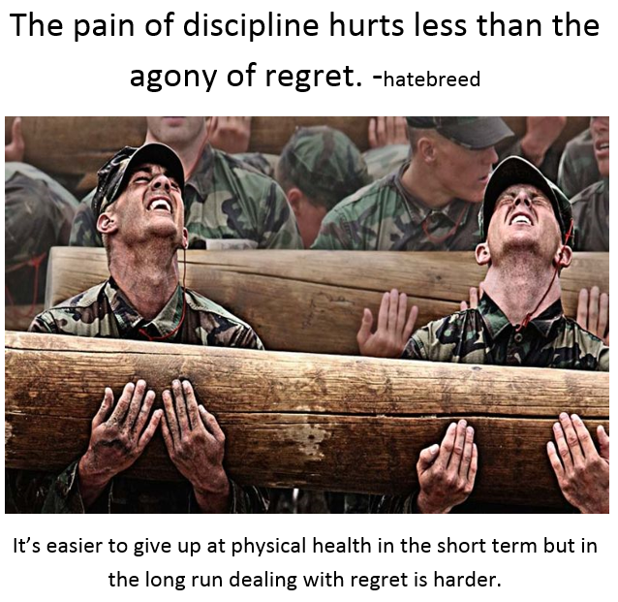
Physical Health
Put a picture and a quote that represents yourself in this component.

Slide 9
Bucket List Dreams & Goals
Can be pictures or lists

Slide 10
Questions & Answers of Self
What understandings do you have of self?
?
What questions do you have to better understand self?
?
What do you wanting to learn?
?
One “Personal Artifact” that represents you in this health component.

Slide 11
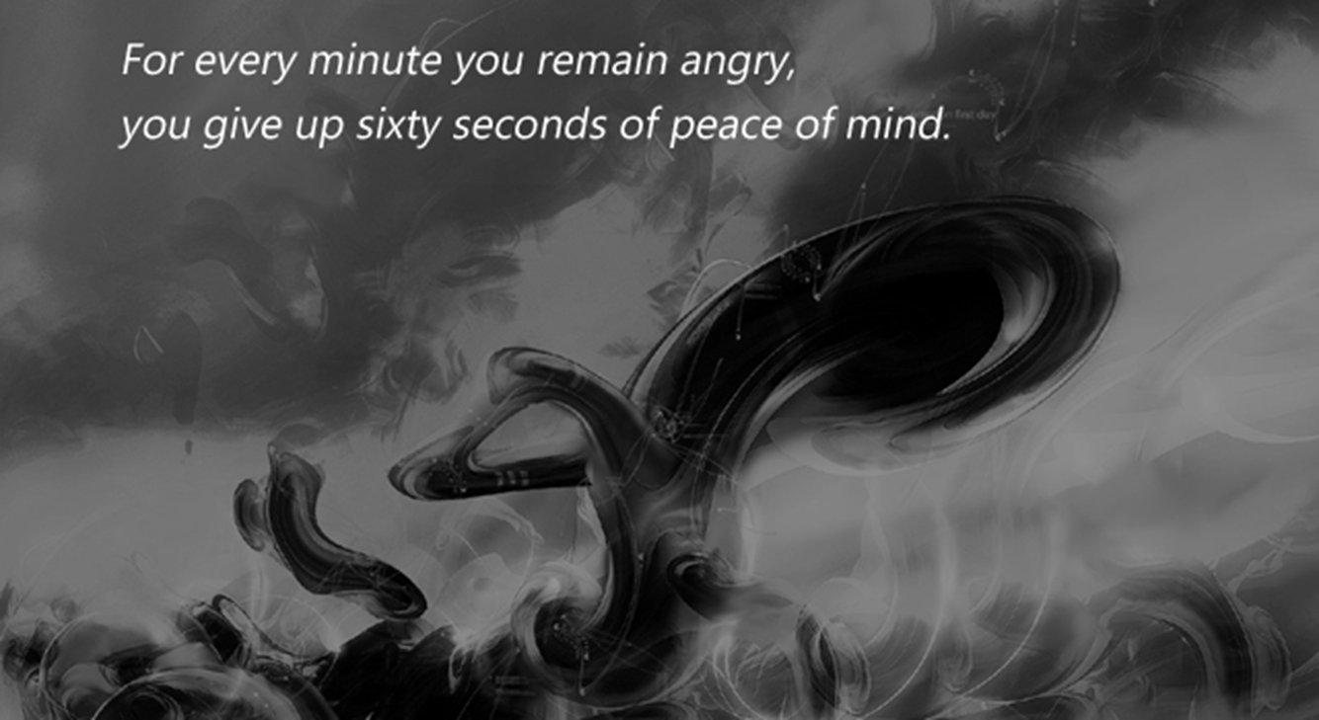
Emotional/ Mental Health
Put a picture and a quote that represents yourself in this component.

Slide 12
Bucket List Dreams & Goals
Can be pictures or lists

Slide 13
Questions & Answers of Self
What understandings do you have of self?
?
What questions do you have to better understand self?
?
What do you wanting to learn?
?
One “Personal Artifact” that represents you in this health component.

Slide 14
Career Health
Put a picture and a quote that represents yourself in this component.
YOU DECIDE YOUR OWN FATE.
CHOOSE WHAT ROAD TO TAKE

Slide 15
Bucket List Dreams & Goals
Can be pictures or lists

Slide 16
Questions & Answers of Self
What understandings do you have of self?
?
What questions do you have to better understand self?
?
What do you wanting to learn?
?
One “Personal Artifact” that represents you in this health component.

Slide 17
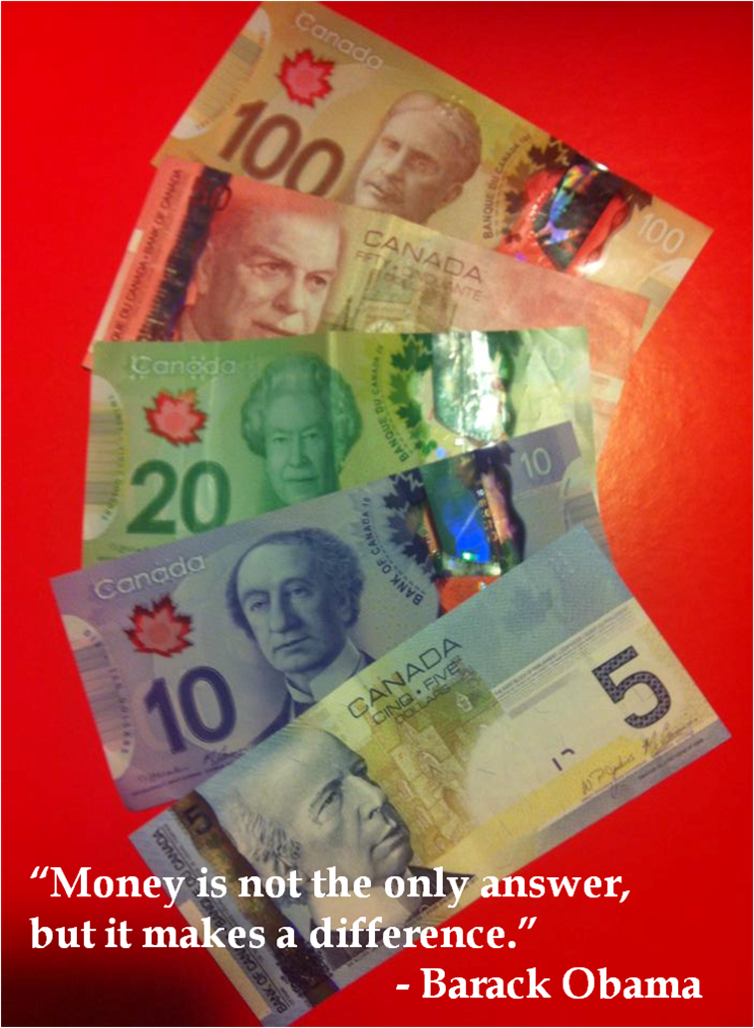
Financial Health
Put a picture and a quote that represents yourself in this component.

Slide 18
Bucket List Dreams & Goals
Can be pictures or lists

Slide 19
Questions & Answers of Self
What understandings do you have of self?
?
What questions do you have to better understand self?
?
What do you wanting to learn?
?
One “Personal Artifact” that represents you in this health component.

Slide 20
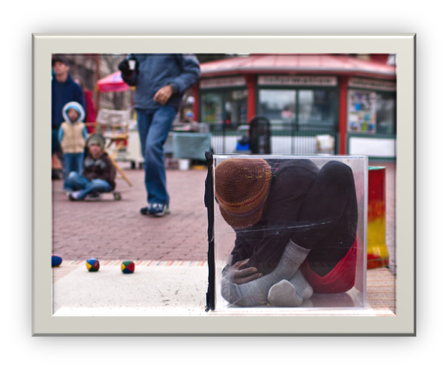
Social Health
Put a picture and a quote that represents yourself in this component.
Because you see your self in them

Slide 21
Bucket List Dreams & Goals
Can be pictures or lists

Slide 22
Questions & Answers of Self
What understandings do you have of self?
?
What questions do you have to better understand self?
?
What do you wanting to learn?
?
One “Personal Artifact” that represents you in this health component.

Slide 23
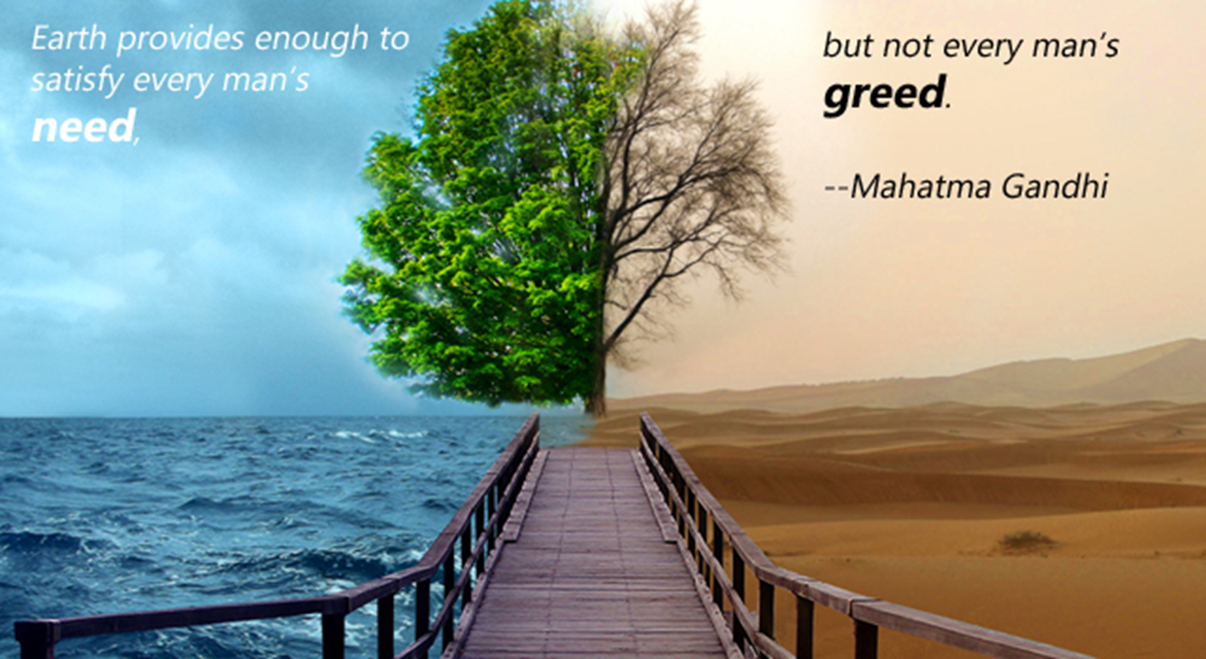
Environmental Health
Put a picture and a quote that represents yourself in this component.

Slide 24
Bucket List Dreams & Goals
Can be pictures or lists

Slide 25
Questions & Answers of Self
What understandings do you have of self?
?
What questions do you have to better understand self?
?
What do you wanting to learn?
?
One “Personal Artifact” that represents you in this health component.

Slide 26
Spiritual Health
Put a picture and a quote that represents yourself in this component.

Slide 27
Bucket List Dreams & Goals
Can be pictures or lists

Slide 28
Questions & Answers of Self
What understandings do you have of self?
?
What questions do you have to better understand self?
?
What do you wanting to learn?
?
One “Personal Artifact” that represents you in this health component.

